Slide 1
Building a polymer
Dehydration synthesis reaction
joins monomers by releasing H₂O
Water is created and given off
requires energy & enzymes

Slide 2
Dehydration synthesis reaction

Slide 3
How to break down a polymer
Hydrolysis reaction
use H₂O to break apart monomers
H₂O is split into H and OH and they attach where the covalent bond used to be
ex: digestion is hydrolysis
Notes:
Most macromolecules are polymers
• build:
condensation (dehydration) reaction
• breakdown:
hydrolysis
An immense variety of polymers can be built from a small set of monomers

Slide 4
Review:
What type of chemical reaction builds polymers?
What type of chemical reaction breaks down polymers?

Slide 5
Chemical reactions
Making (uses energy) and breaking (releases energy) of chemical bonds leading to form new molecules
Reactions cannot create or destroy matter, only rearrange it
6CO₂ + 6H₂O → C₆H₁₂O₆ +6O₂
In a chemical reaction the reactant(s) are converted to the product(s)
Reactants Products

Slide 6
Checkpoint:
What is activation energy or energy of activation?
The energy required to start an energy-absorbing reaction.
Which type of reaction would require a larger input of energy – one that makes polymers or one that breaks them down into monomers?

Slide 7
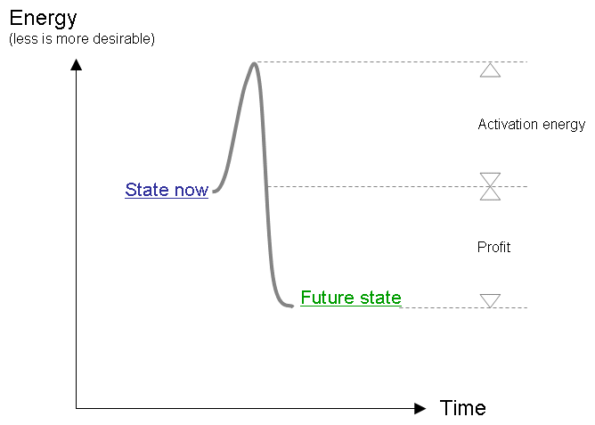

Slide 8
Reducing Activation energy requires: CAtalysts
Something that reduces the amount of energy to start a reaction
uncatalyzed reaction
catalyzed reaction
NEW (lower) activation energy
reactant
product

Slide 9
What is an enzyme?
A biological catalyst (act in living things)
made from protein – 3D shape is important!!!
Not used up or changed by the reaction – can be used over and over again

Slide 10
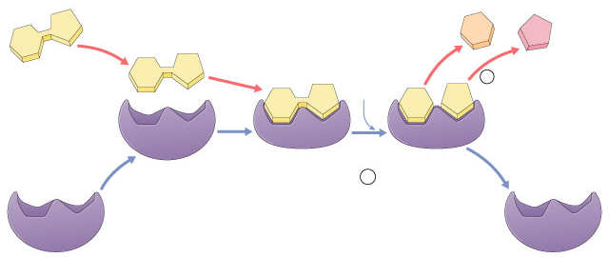
Enzymes vocabulary
substrate
Reactant(s) which binds to enzyme
enzyme-substrate complex: temporary association
product
end result of reaction, what is produced
active site
enzyme’s catalytic site; substrate fits into active site
active site
substrate
products
Enzyme-substrate
complex
enzyme

Slide 11
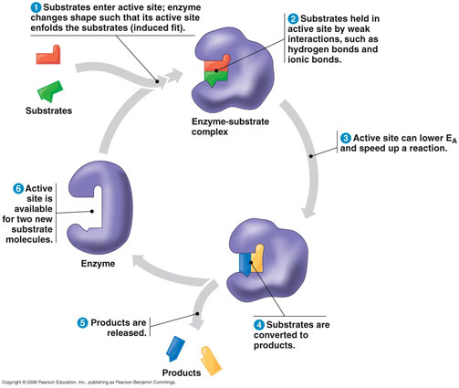
How does an enzyme function?

Slide 12
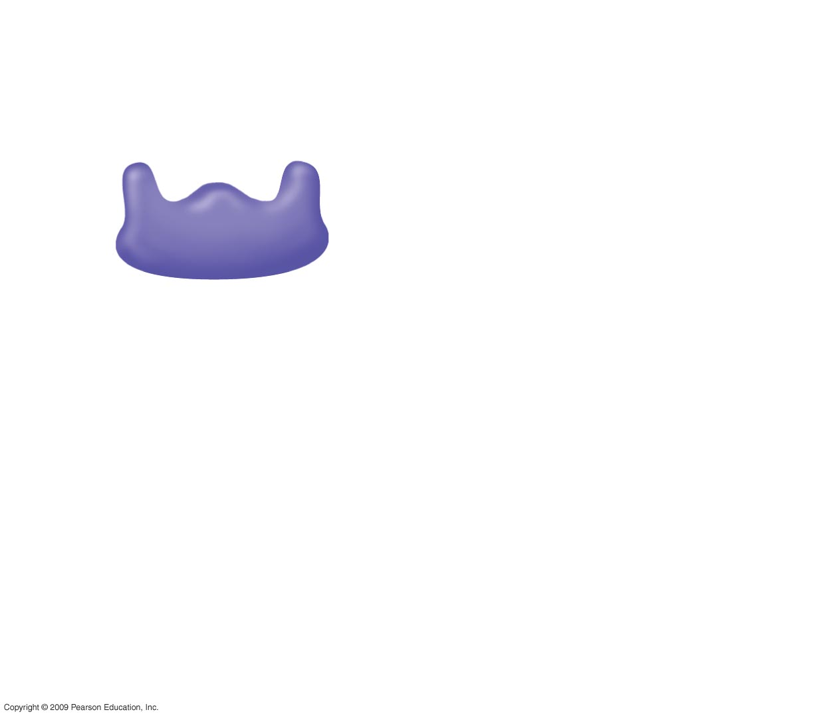
1
Enzyme available
with empty active
site
Active site
Enzyme
(sucrase)
Notes:
Figure 5.15 The catalytic cycle of an enzyme.

Slide 13
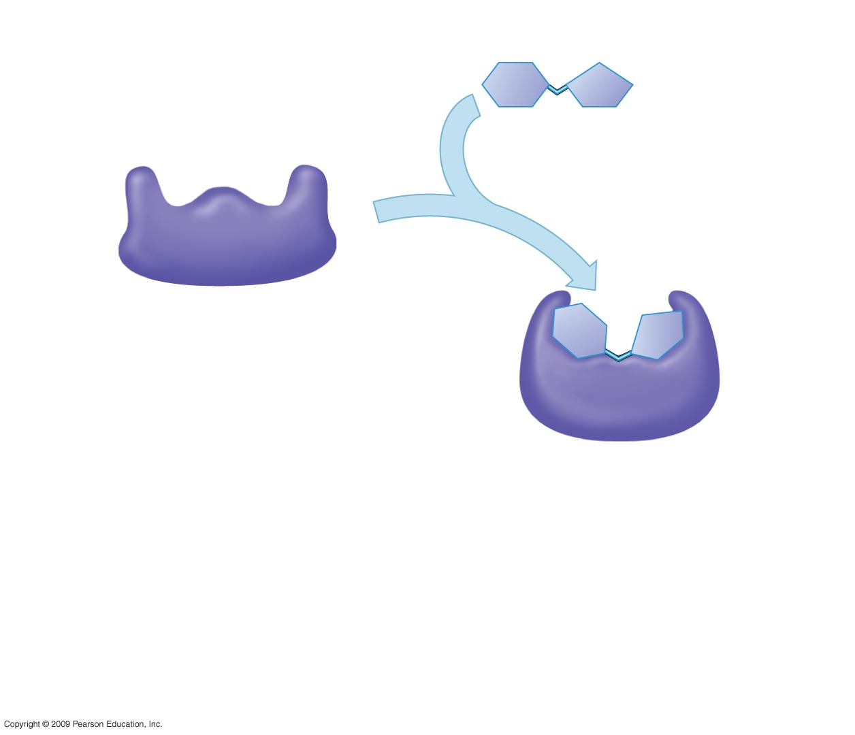
1
Enzyme available
with empty active
site
Active site
Substrate
(sucrose)
2
Substrate binds
to enzyme with
induced fit
Enzyme
(sucrase)
Notes:
Figure 5.15 The catalytic cycle of an enzyme.

Slide 14
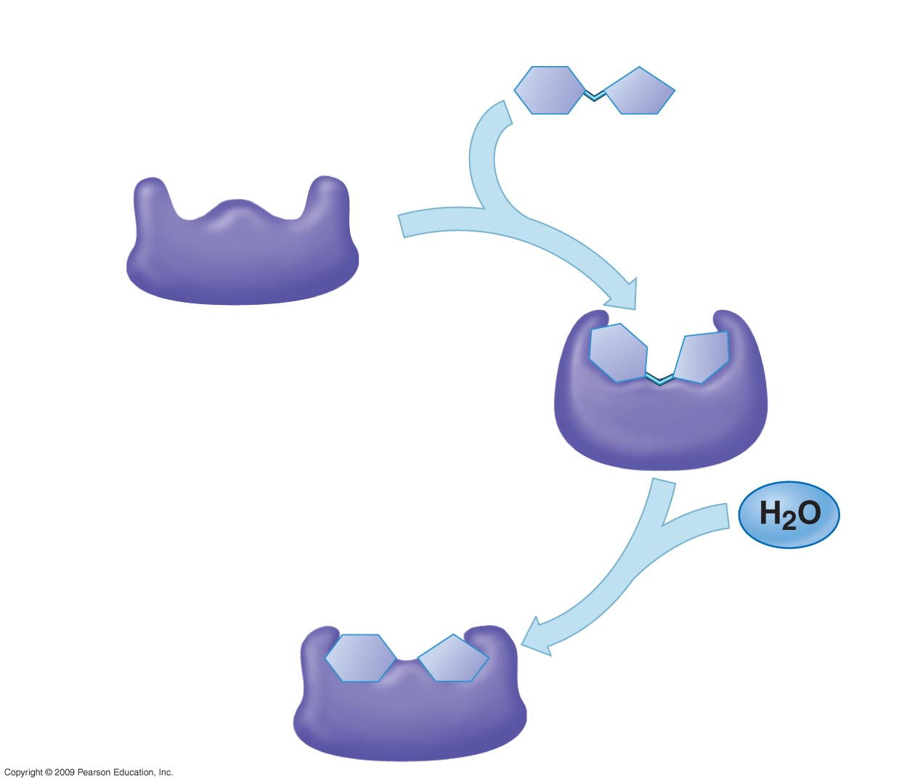
1
Enzyme available
with empty active
site
Active site
Substrate
(sucrose)
2
Substrate binds
to enzyme with
induced fit
Enzyme
(sucrase)
3
Substrate is
converted to
products
Notes:
Figure 5.15 The catalytic cycle of an enzyme.

Slide 15
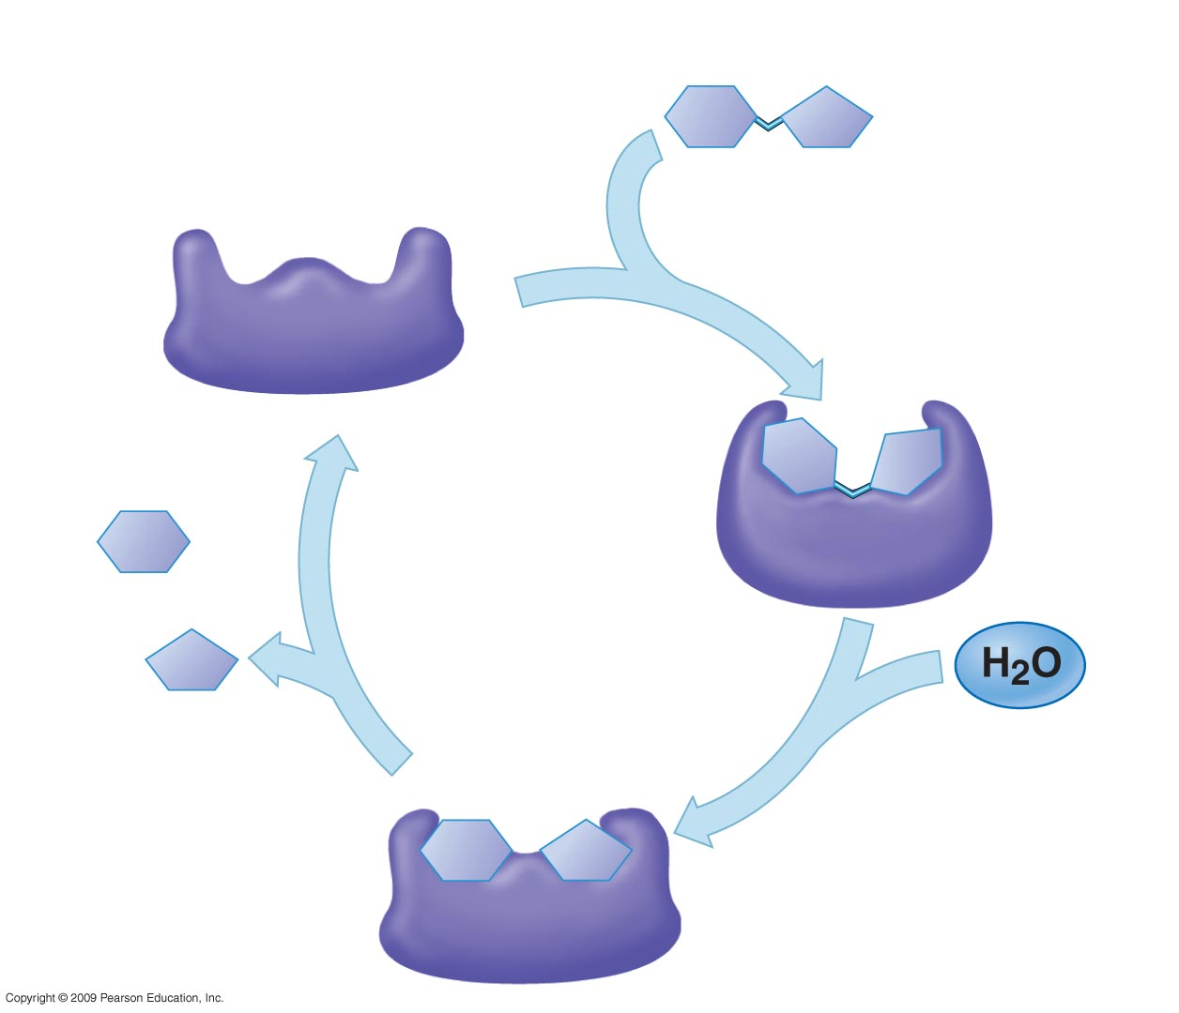
1
Enzyme available
with empty active
site
Active site
Substrate
(sucrose)
2
Substrate binds
to enzyme with
induced fit
Enzyme
(sucrase)
Glucose
Fructose
4
Products are
released
3
Substrate is
converted to
products
Notes:
Figure 5.15 The catalytic cycle of an enzyme.

Slide 16
Checkpoint:
How do enzymes speed up reactions?

Slide 17
Why are enzymes and substrates generally compared to a lock and key?
Enzymes are substrate specific
their active sites are shaped to only fit one type of substrate
Enzymes can only catalyze one type of reaction, just like a key can only open one lock.

Slide 18
What factors affect the ability of enzymes to function?
Temperature
pH
If the environment is too hot or the pH is too high or too low → enzymes will denature
This means that they lose their shape and no longer function or work (the key no longer fits the lock!)

